Slide 1
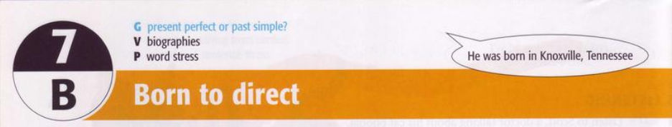
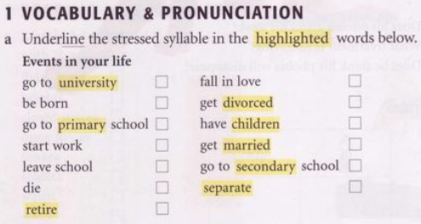


5
7
1
11
2
9
6
8
4
3
13
10
12

Slide 2
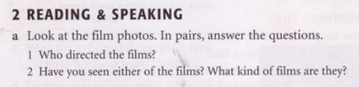
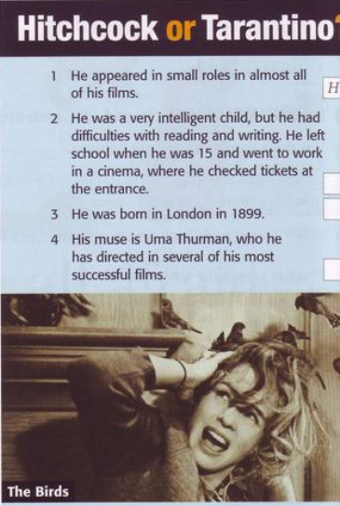
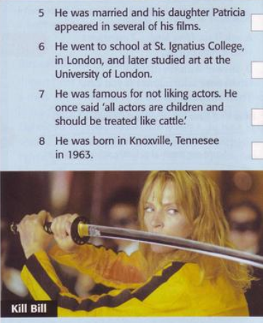
H
H
T
H
H
T
T

Slide 3
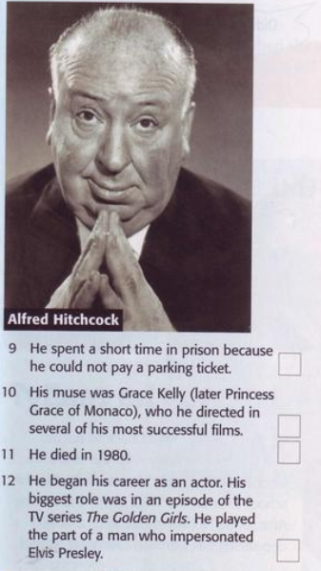
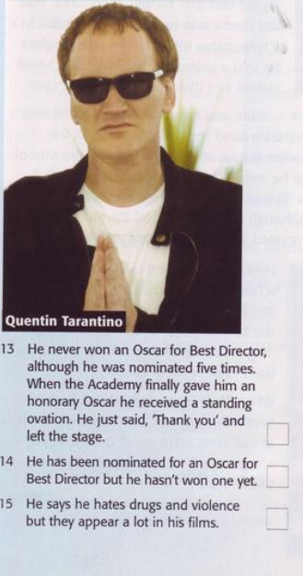
T
H
H
H
T
T
T

Slide 4
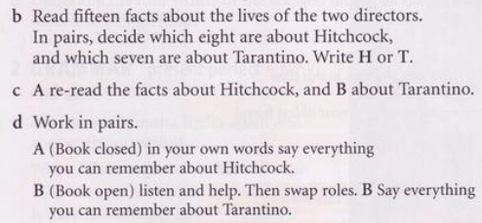

Slide 5
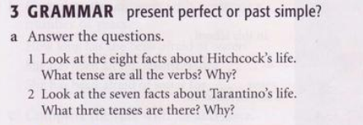
Form & usage
Simple Past | Present Perfect Simple
S + V(-ed) | I / you / we / they + have + Vpp he / she / it + has + Vpp
A finished action in the past. | An action happened in the past but related up to now

Slide 6
Present Perfect Simple | Past Simple
Unfinished actions that started in the past and continue to the present: I've known John for ten years (and I still know him). | Finished actions: I knew John ten years ago (but then he moved away and we lost touch).
A finished action in someone's life (when the person is still alive: life experience): My brother has been to Mexico three times. | A finished action in someone's life (when the person is dead): My great-grandmother went to Mexico three times.
A finished action with a result in the present: I've lost my keys! (The result is that I can't get into my house now). | A finished action with no result in the present: I lost my keys yesterday. It was terrible! (Now there is no result. I got new keys yesterday).
With an unfinished time word (this week, this month, today): I've seen John this week. | With a finished time word (last week, last month, yesterday): I saw John last week.

Slide 7
Signal Words
Simple Past | Present Perfect Simple
yesterday ... ago in 1990 the other day last ... | just already up to now until now / till now ever (not) yet so far lately / recently

Slide 8
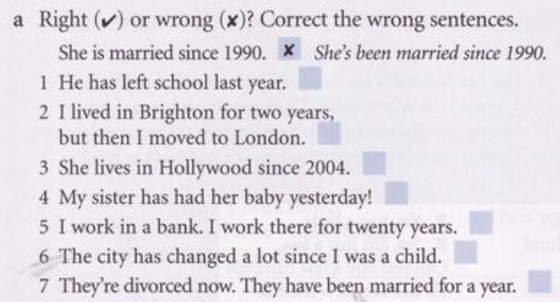
x
He left school last year
v
x
She has lived in Hollywood since 2004
v
My sister had a baby yesterday
x
I work in a bank. I ‘ve worked there for 20 years
v
x
They’re divorced now. They were married for a year

Slide 9
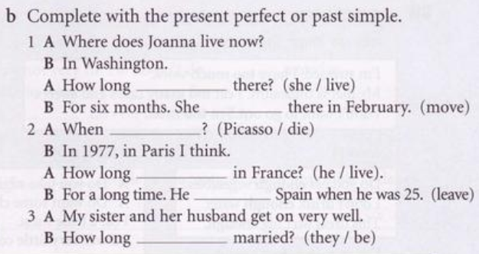
did she live
moved
did Picasso die
has he lived
left
have they been

Slide 10
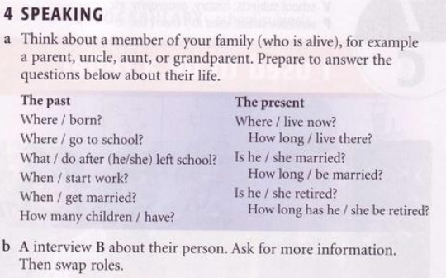

Slide 11
